Slide 1
Thesis Writing
What is a Thesis?
It is usually a single sentence at the end of your first paragraph that presents your argument to the reader.
Why write a thesis?
You are taking a stand on an argument!
To show your point of view!
NEVER USE I!

Slide 2
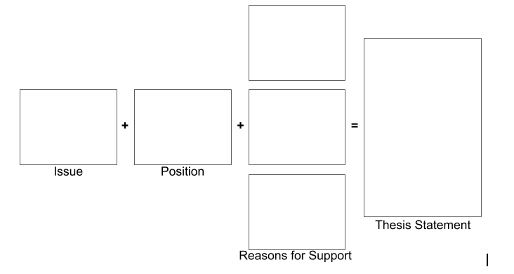
Remember

