Slide 1
Darn Parents

Slide 2
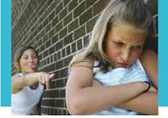
Troublesome Friends
Your parents are concerned that you are hanging out with troublesome older friends. They tell you to stay away and avoid these troublesome friends.
Do you still hang out with them?

Slide 3
Treehouse Problem
You start to play in a really cool tree house near your backyard with your troublesome friends. Your friends tell you that the tree house belongs to them, but your dad disagrees. He says that it lies within your family’s property and belongs to your family. Your friends disagree and begin to pick on you every time you try and enter the tree house. One day your dad sees this and kicks all the troublesome kids out.
Your parents banish you from the tree house. They tell you to stay out and avoid future problems with the troublesome kids.
Do you stay out?

Slide 4
Fence issue
Your parents take away your allowance so they can build a big fence to keep all of your troublesome friends out of the tree house.
How do you respond?

Slide 5
Pay to play
Your parents agree to give you back your allowance. However, to show you who’s boss, they tell you that you will have to start paying to play your video games and use your cellphone.
How do you respond?

Slide 6
Video game situation
Your parents tell you you can play video games again, but you can ONLY play games they select. The game they have selected is “Rock Band: Sesame Street”.
How do you respond?

Slide 7
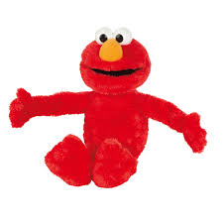
Sesame Street mania
You destroy your family’s copy of “Rock Band: Sesame Street”. Your mom freaks out; it was her favorite game! She banishes you to your room and takes away your allowance and cellphone. She disables the internet connection so you have no way of communicating with your friends. You are no longer allowed to leave the house until the game is paid for. You must also apologize to your parents and prove your commitment to the family by singing all of the Sesame Street songs out loud in the front yard.
How do you respond?

Slide 8
iPod Threat!
Your parents have discovered that you have hidden an iPod touch and a cellphone in your closet. They heard you using them both one night. Your sister overheard your parents whispering their secret plan. Your parents plan on sneaking into your room and confiscating your last prize possessions.
How do you respond?

Slide 9
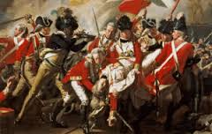
Darn British
EQ: What actions by the British government pushed the American colonists to rebel and cause the outbreak of the American Revolutionary War?

Slide 10
Troublesome friends= Navigation Acts
The British did not want the American colonists to trade with any other countries. The colonists could only buy and sell with Great Britain.
What do the troublesome friends represent?
Why did the British want the colonists to only trade with them?

Slide 11
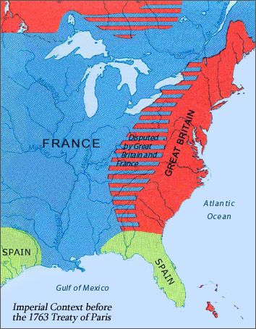
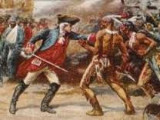
TREEHOUSE PROBLEM= FRENCH & INDIAN WAR
The British (and their American colonists) battled the French and their Indian allies for control of the interior of the continent
To prevent future conflict and another war, the British drew a line down the Appalachians and told the Americans to stay out. ( Known as the Proclamation of 1763)
Did the colonists stay out?

Slide 12
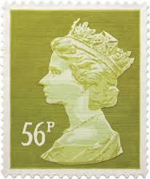
Fence Issue= Stamp Act
The British sent troops to the colonies to “protect” the Americans. The British government created a tax on stamps to help cover the cost of the soldier.
What does taking your allowance represent?
Why did the British send troops to America?

Slide 13
Pay to Play= Townshend Acts
The British eventually eliminated the Stamp Act due to protest. However, they later passed the Townshend Acts as a way to tax luxury goods and maintain discipline over the colonists.
What do the video games and cellphone represent?
What type of goods did the Townshend Acts tax?

Slide 14
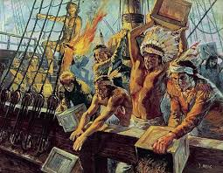
Video Situation= Tea Act
The British withdrew almost all parts of the Townshend Act except for the laws on tea. This tax angered the colonists because it allowed the British East India Company to monopolize the tea market in the colonies.
What does the game represent?
How did the colonists react to the Tea Act?

Slide 15
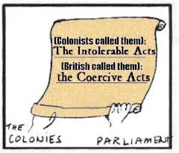
Sesame Street Mania= Coercive Acts
The Coercive Acts were meant to punish the colonists for the Boston Tea Party. The Acts closed the Port of Boston until the tea was paid for, eliminated town meetings, removed judges from the colonies and set strict curfews.
Why did the British pass the Coercive Acts (Intolerable Acts)?

Slide 16
iPod Threat= Lexington & Concord
The British realized that the Americans were stockpiling weapons. They decided to sneak out of Boston in the middle of the night to capture the weapons in Concord. However, the American colonists tried to stop the British army at Lexington, but failed.
How did the colonists respond?

