Slide 1
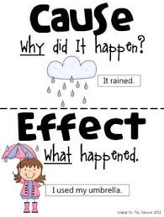
Cause and Effect

Slide 2
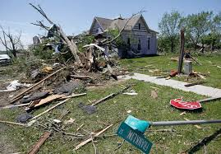
Cause and Effect
Many times one event causes something else to happen. The cause comes first, and then the result or effect can be seen. The cause leads to the effect.
Example: The tornado caused a lot of damage.

Slide 3
Cause and Effect
Directions: Underline the cause in green and underline the effect in blue for each sentence. The cause does not necessarily come first in each sentence.
1. In addition to extreme overpopulation, extended drought has contributed to severe famine in Ethiopia and other parts of Africa.
2. Population growth in the Sunbelt States has come from many companies relocating to that area.
3. The emigration of the first pilgrims from England to the New World was prompted by religious persecution in their homeland.
4. Unfair employer practices brought about the establishment of labor unions.

Slide 4
Cause and Effect
During winter some southern states have such extremely low temperatures that the frost line reached Florida, damaging the state’s orange crop. Many oranges were lost. On the television news, it was predicted that consumers would soon be forced to pay more for orange products at the store.
Cause | Effect

